Slide 1
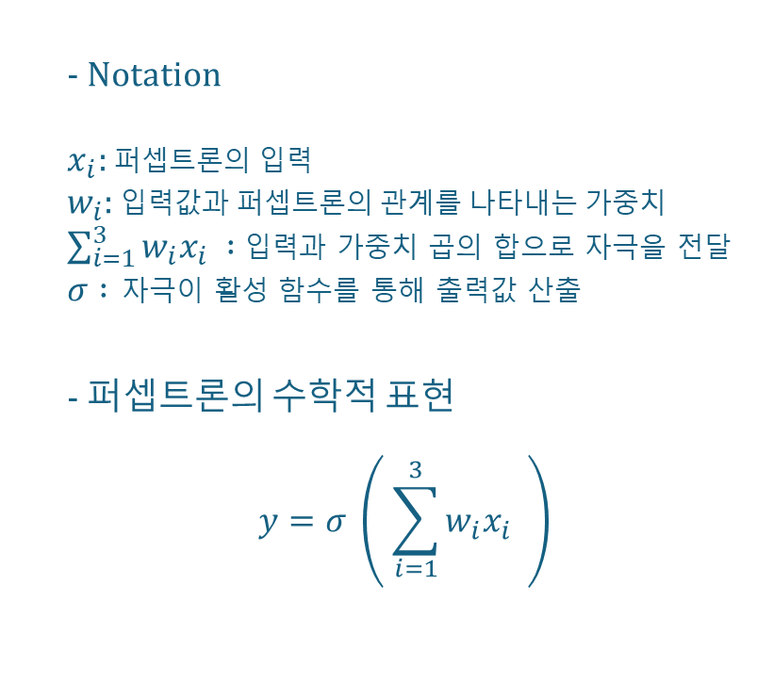









MLP - 퍼셉트론
- Notation
$x_{i}:$ 퍼셉트론의 입력
$w_{i}:$ 입력값과 퍼셉트론의 관계를 나타내는 가중치
$\sum_{i=1}^{3}{w_{i}x_{i} } :$입력과 가중치 곱의 합으로 자극을 전달
$σ :$ 자극이 활성 함수를 통해 출력값 산출
- 퍼셉트론의 수학적 표현
$$y=σ \left( \sum_{i=1}^{3}{w_{i}x_{i} } \right)$$
입력
가중치
$$x_{1}$$
$$w_{1}$$
가중합
활성함수
출력
$$w_{2}$$
$$∑$$
$$x_{2}$$
$$σ$$
$$y$$
$$w_{3}$$
$$x_{3}$$

Slide 2












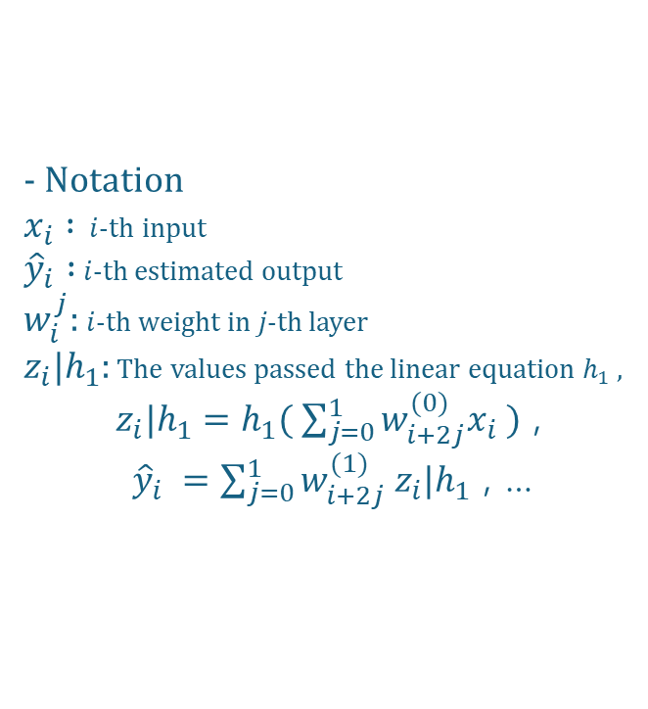


Propagation - Forward Propagation
- Notation
$x_{i} :$ $i$-th input
${\hat{y}}_{i} :$ $i$-th estimated output
$w_{i}^{j}:$ $i$-th weight in $j\text{−}$th layer
$z_{i}|h_{1}$: The values passed the linear equation $h_{1}$ ,
$z_{i}|h_{1}=h_{1}( \sum_{j=0}^{1}{w_{i+2j}^{(0)}x_{i} )}$ ,
${\hat{y}}_{i} =\sum_{j=0}^{1}{w_{i+2j}^{(1)}{ z}_{i}|h_{1}}$ , …
Input
Layer
Hidden
Layer
Output
Layer
$$x_{1}$$
$$w_{1}^{(0)}$$
$${ z}_{1}|h_{1}$$
$$w_{1}^{(1)}$$
$${ \hat{y}}_{1}$$
$$w_{2}^{(0)}$$
$$w_{2}^{(1)}$$
$$x_{2}$$
$$w_{3}^{(0)}$$
$${ z}_{2}|h_{1}$$
$$w_{3}^{(1)}$$
$${ \hat{y}}_{2}$$
$$w_{4}^{(0)}$$
$$w_{4}^{(1)}$$

Slide 3
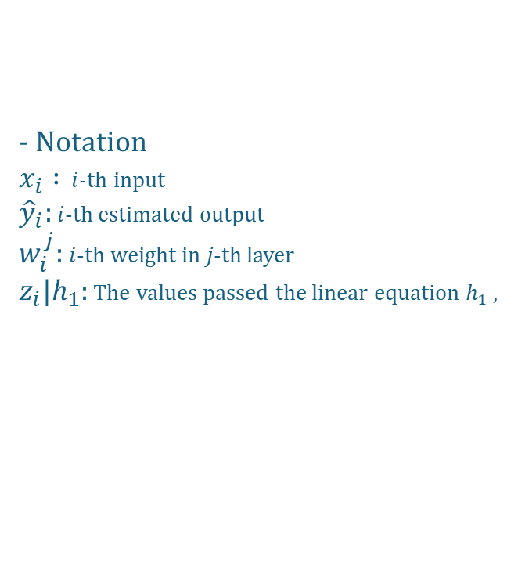
Propagation - Back Propagation
- Notation
$x_{i} :$ $i$-th input
${\hat{y}}_{i}:$ $i$-th estimated output
$w_{i}^{j}:$ $i$-th weight in $j\text{−}$th layer
$z_{i}|h_{1}$: The values passed the linear equation $h_{1}$ ,
Input
Layer
Hidden
Layer
Output
Layer
$$x_{1}$$
$$w_{1}^{(0)}$$
$${ z}_{1}|h_{1}$$
$$w_{1}^{(1)}$$
$${ \hat{y}}_{1}$$
$$w_{2}^{(0)}$$
$$w_{2}^{(1)}$$
$$x_{2}$$
$$w_{3}^{(0)}$$
$${ z}_{2}|h_{1}$$
$$w_{3}^{(1)}$$
$${ \hat{y}}_{2}$$
$$w_{4}^{(0)}$$
$$w_{4}^{(1)}$$

Slide 4
CNN – Covolution Operation
1 | 0 | 3 | 2
4 | 1 | 2 | 1
1 | 2 | 3 | 4
2 | 0 | 0 | 1
1 | 2 | 3
3 | 1 | 2
2 | 3 | 1
38 | 34
27 | 26
*
=
Data
Kernel
Output
Convolution Operation
(1,1) = 1*1 + 0*2 + 3*3 + (1,2) = 0*1 + 3*2 + 2*3 +
4*3 + 1*1 + 2*2 + 1*3 + 2*1 + 1*2 +
1*2 + 2*3 + 3*1 2*2 + 3*3 + 4*1
(2,1) = 4*1 + 1*2 + 2*3 + (2,2) = 1*1 + 2*2 + 1*3 +
1*3 + 2*1 + 3*2 + 2*3 + 3*1 + 4*2 +
2*2 + 0*3 + 0*1 0*2 + 0*3 + 1*1

Slide 5
CNN – Padding
0 | 0 | 0 | 0
0 | 1 | 2 | 0
0 | 2 | 3 | 0
0 | 0 | 0 | 0
1 | 2 | 3
3 | 1 | 2
2 | 3 | 1
14 | 18
16 | 15
*
=
Data
Kernel
Output
Convolution Operation
(1,1) = 0*1 + 0*2 + 0*3 + (1,2) = 0*1 + 0*2 + 0*3 +
0*3 + 1*1 + 2*2 + 1*3 + 2*1 + 0*2 +
0*2 + 2*3 + 3*1 2*2 + 3*3 + 0*1
(2,1) = 0*1 + 1*2 + 2*3 + (2,2) = 1*1 + 2*2 + 0*3 +
0*3 + 2*1 + 3*2 + 2*3 + 3*1 + 0*2 +
0*2 + 0*3 + 0*1 0*2 + 0*3 + 0*1

Slide 6
CNN – Stride
1 | 0 | 4 | 2 | 1
0 | 1 | 2 | 1 | 3
0 | 2 | 3 | 5 | 1
4 | 1 | 3 | 1 | 2
2 | 5 | 4 | 0 | 4
1 | 2 | 3
3 | 1 | 2
2 | 3 | 1
27 | 46
55 | 42
*
=
Data
Kernel
Output
Convolution Operation
(1,1) = 1*1 + 0*2 + 4*3 + (1,2) = 4*1 + 2*2 + 1*3 +
0*3 + 1*1 + 2*2 + 2*3 + 1*1 + 3*2 +
0*2 + 2*3 + 3*1 3*2 + 5*3 + 1*1
(2,1) = 0*1 + 2*2 + 3*3 + (2,2) = 3*1 + 5*2 + 1*3 +
4*3 + 1*1 + 3*2 + 3*3 + 1*1 + 2*2 +
2*2 + 5*3 + 4*1 4*2 + 0*3 + 4*1

Slide 7
CNN – Max Pooling (2x2)
1 | 0 | 3 | 2
4 | 1 | 2 | 1
1 | 2 | 3 | 4
2 | 0 | 0 | 1
2x2 Max
Pooling
2 | 3
4 | 4
*
=
Data
Output

Slide 8
CNN – Average Pooling (2x2)
1 | 0 | 3 | 2
4 | 1 | 2 | 1
1 | 2 | 3 | 4
2 | 0 | 0 | 1
Average
Pooling
6/4 | 2
5/4 | 2
*
=
Data
Output

Slide 9
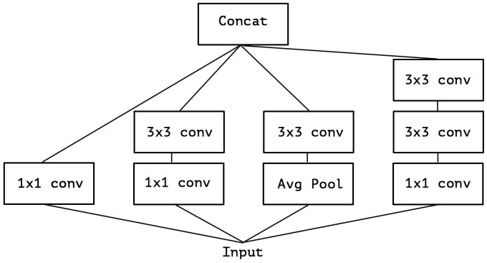
spatial correlation 계산
cross-channel
correlation 계산
진행
방향

